Slide 1
Parkland College Developmental Math Redesign
What Have We Learned?
Brian Mercer and Erin Wilding-Martin

Slide 2
Redesign Goals
Make the track for college algebra-bound students better
More rigor, attention to concepts that sabotage algebra skills
Faster pace
More responsibility placed on students
Create a new track for gen-ed bound students
Keep core algebra content
De-emphasize by-hand algebraic simplification
Add more applications, exploration, and writing
Use technology

Slide 3
Flow Chart for the New Curriculum

Slide 4
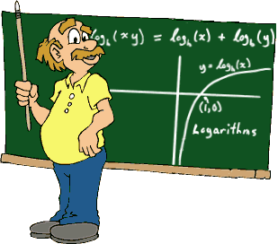
College Algebra-Bound Track
Focus on Intermediate Algebra
Added exponentials and logarithms to increase algebraic rigor and pace of the course
Split course into two 7-weeks halves to increase pace
Cover all topics more in-depth and with more rigor

Slide 5
Gen Ed Track (Mathematical Literacy)
Topics chosen to prepare students for General Education Mathematics and Statistics, and Life
Algebra addressed in context, focus on numeracy and functions
Data analysis and modeling integrated throughout
Incorporate reading, writing, technology

Slide 6
Gen Ed Track (Mathematical Literacy)
Group-based problem-solving pedagogy
Use an online homework system for more skill practice outside of class
Work on problem-solving, critical thinking, and conceptual understanding in class
Look at real data, explore patterns, create models, solve problems, have fun

Slide 7
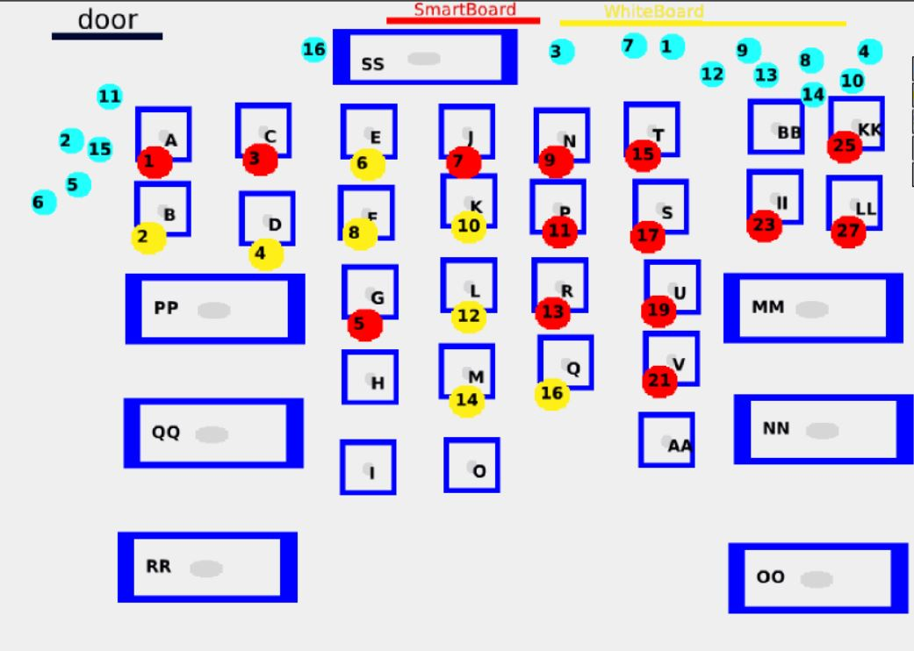
A Traditional Classroom

Slide 8
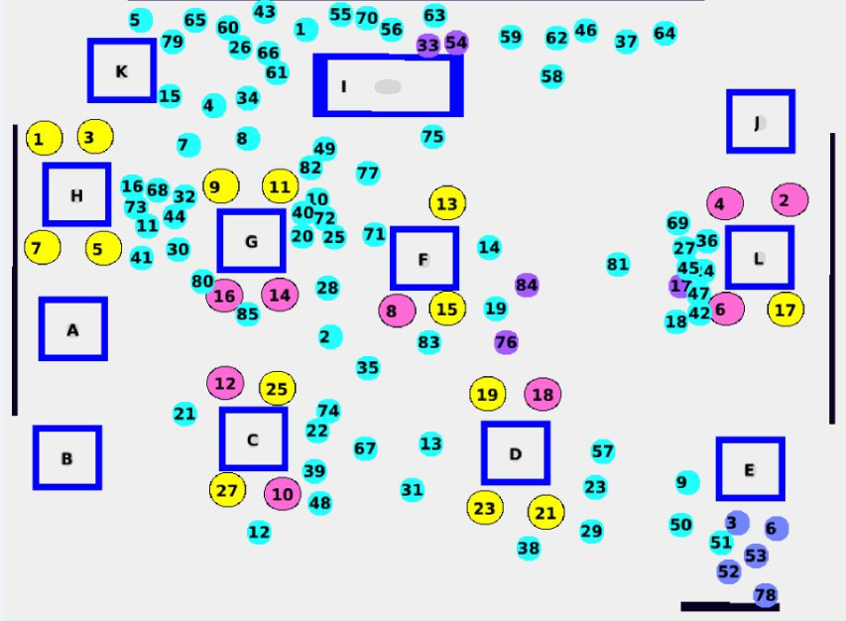
A Math Lit Classroom

Slide 9
The Data so Far
Success rates for Fall 2013 (C or better)
73% in Math Lit A and 76% in Math Lit B
55% successfully completed the entire Math Lit sequence
Compared to historical average in traditional track of approximately 50% in Beg Alg and 50% in Int Alg
Success in subsequent courses
Pilot students completing Math Literacy in Spring 2013 had 75% success in Intro to Statistics and Liberal Arts Math on first attempt
Compared to 69% success on any attempt in same courses for traditional track students over years 2008-2012

Slide 10
Student Feedback (Survey of 127 students)
Content
Most found at least some of the content to be relevant
Some even listed specific topics such as compound interest
Assignments
Many complaints about Excel assignments
Several commented that they didn’t see the point of the Reflections
Mixed review of ALEKS skills assignments
Some love the independent practice
Some do not see the connection to classroom topics

Slide 11
Student Feedback (Survey of 127 students)
Group work – students were split
Many loved working in groups instead of lecture
“Working in groups was informative—gave more information than I would have expected.”
“Much better [than other math classes]. Less intimidating. Much more relaxed and more comfortable.”
“More teacher/student interaction as opposed to a 2-hour lecture.”
Many hated the groups
Prefer lecture
Feel that “the teacher doesn’t teach,” and you have to “teach yourself”
Overall opinions of the course
52 liked it better than other math courses
38 thought it was worse than other math courses
37 were neutral or had a mixed review

Slide 12
Instructor Feedback (Survey of 10 Instructors)
Most (8) said they definitely enjoyed teaching the class; All said they would request it again
Fun, closer interaction with students
“The interaction with the students is exhausting and exciting at the same time.”
“I get to know the students as people earlier on during the semester-- faster than I would be able to with a lecture course.”
Challenges
Group dynamics, facilitating good group work
Explaining to students the reason for discovery learning
Making sure group work doesn’t “pad” the grade
Technology skills

Slide 13
Plans for Improvement
STUDENTS
Student expectations and buy-in
Make the course philosophy more transparent
Work on developing “grit”
Technology skills
Work with students on technology skills in class
Group dynamics
Get ideas for better group facilitation like assigning roles
Individual accountability
Individual homework quizzes

Slide 14
Plans for Improvement
INSTRUCTORS
Technology skills
Require instructors to have some tech comfort before teaching the course
Work with instructors on skills specific to the course
Pedagogy buy-in and comfort
More informal classroom visits, conversations, and support
Philosophy and rationale for the pedagogy
Importance of setting the right tone and “selling” the course to students
Managing group dynamics
Balance between giving students room to think and providing help

Slide 15
Other Implementation Issues
Off-cycle sections
Unique challenges with so many repeaters in one class
Online format
How to make it authentic to the philosophy of the course?
8-week split
Are we losing students who would have passed if the courses were combined?

Slide 16
Contact info
Erin Wilding-Martin emartin@parkland.edu Brian Mercer bmercer@parkland.edu

